Slide 1
ATOMIC ENERGY EDUCATION SOCIETY DISTANCE EDUCATION PROGRAMME CLASS 8- MATHEMATICS
CHAPTER-3
UNDERSTANDING QUADRILATERALS
MODULE-1/4

Slide 2
Module-1
Polygon - Definition
2) Classification of polygons
3) Diagonal of a polygon
3)Convex & concave polygons
4)Regular and Irregular polygons
5)Angle sum property of a quadrilateral
6) Angle sum property of a polygon
7) Problems.

Slide 3
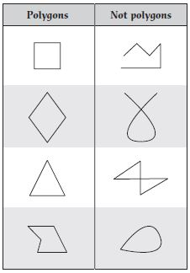
3. Understanding quadrilaterals
Let us learn some terms like polygon, convex &concave polygon, regular & irregular polygon.
1)Polygon- A simple closed figure made up of only line segments is called a polygon.

Slide 4
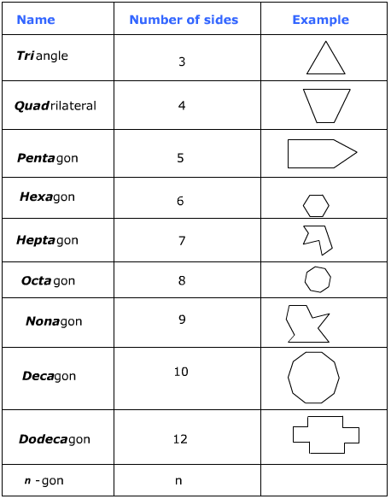
2) For a figure to be a polygon we need minimum 3 line segments. Polygons are classified according to the number of sides. Classification of polygons is as follows.

Slide 5
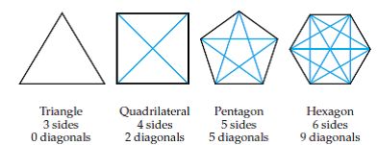
3) Diagonal of a polygon- A line segment joining two non-consecutive vertices is called as a diagonal. Let us see how many diagonals are there in the following polynomials.

Slide 6
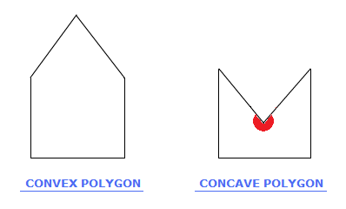
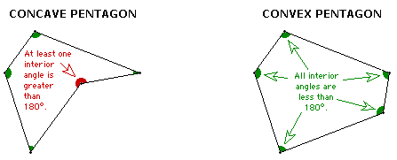
Can you generalise this for a polynomial having ‘n’ sides? No. of diagonals of a polygon = $\frac{n(n−3)}{2}$ , n$>$ 3 of ‘n’ sides
Note – There is only one polygon which has number of sides and number of diagonals same and it is pentagon.
4) Convex and Concave polygon – A polygon is said to be a convex polygon if the line segment joining any two points in its interior lies completely in its interior. A polygon which is not convex Is called as concave polygon.

Slide 7
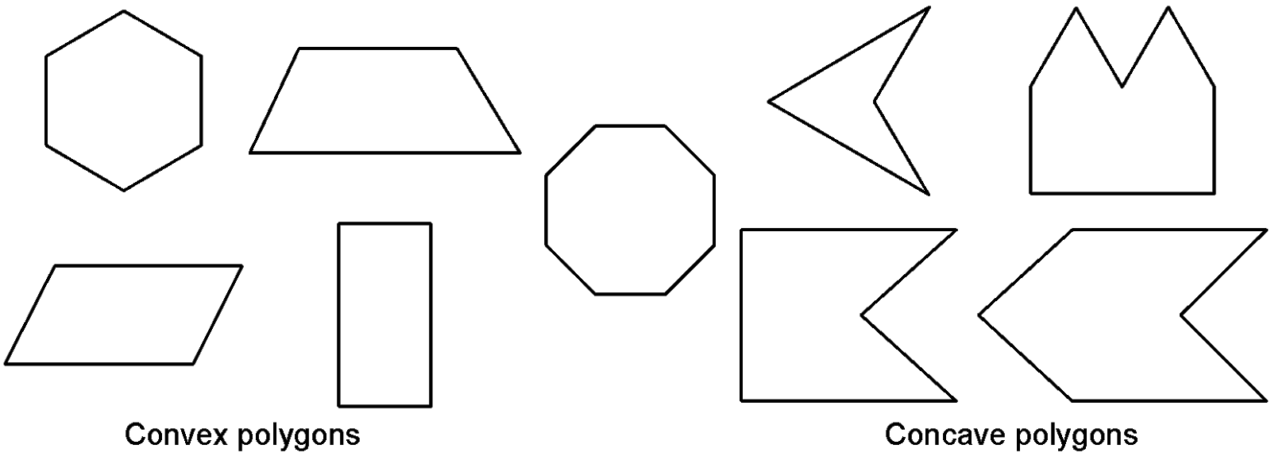
You can see that in a convex polygon each of the interior angles is less than 180$°$ where as in a concave polygon you can see that one of the interior angles is greater than 180$°$.Also in a convex polygon no portion of the diagonal is in its exterior. In a concave polygon one of the diagonal except its end points lies in the exterior of the polygon.
Let us see some more convex and concave polygons.

Slide 8
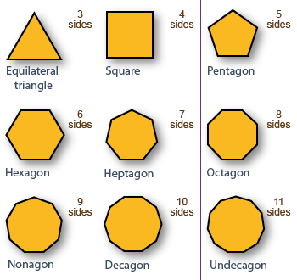
6) Regular and Irregular polygons – A polygon is said to be a regular polygon if all its sides and all its angles are equal.
Let us see some examples of regular and irregular polygons.
Regular polygons Irregular polygons

Slide 9
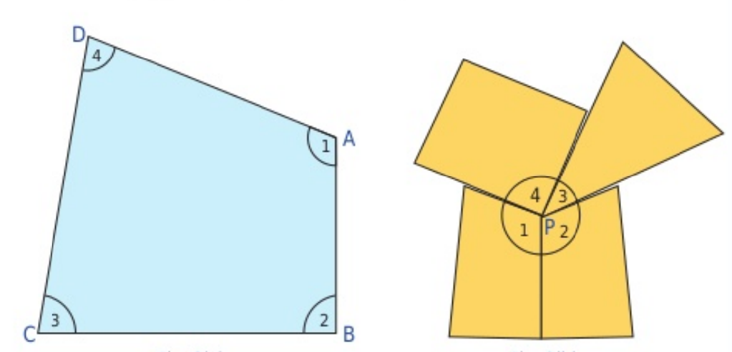
7) Angle sum property of a polygon – We know that sum of the angles of a triangle is 180$°$.Let us find the sum of the angles of a quadrilateral.

Slide 10
This is an activity in which all the four angles of the quadrilateral ABCD are cut and joined together forming a circle.
This implies that sum of the four angles of a quadrilateral is 360$°$ or 2 straight angles or 4 right angles.
i. e. $∠A$ + $∠B$ + $∠C$ + $∠D$ = 360$°$

Slide 11
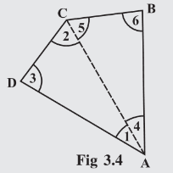
Let us prove that sum of the angles of a quadrilateral is360$°$ In $∆$ABC , $∠$4 + $∠5$ + $∠6$ = 180$°$ -----(1) In $∆$ACD , $∠1$ + $∠2$ + $∠3$ = 180$°$ -----(2) Adding equations (1) and (2), we get, $∠$4 + $∠5$ + $∠6$ + $∠1$ + $∠2$ + $∠3$ = 180 + 180$°$ Or, ($∠1$ + $∠$4) + $∠6$ + ($∠2$ + $∠5$) + $∠3$ = 360$°$ Or, $∠A$ + $∠B$ + $∠C$ + $∠D$ = 360$°$ Hence , sum of the angles of a quadrilateral is 360$°$

Slide 12
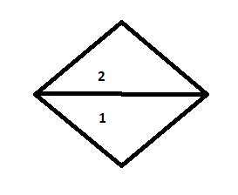
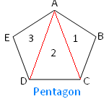
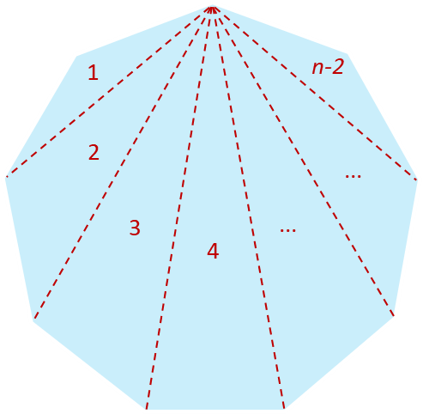
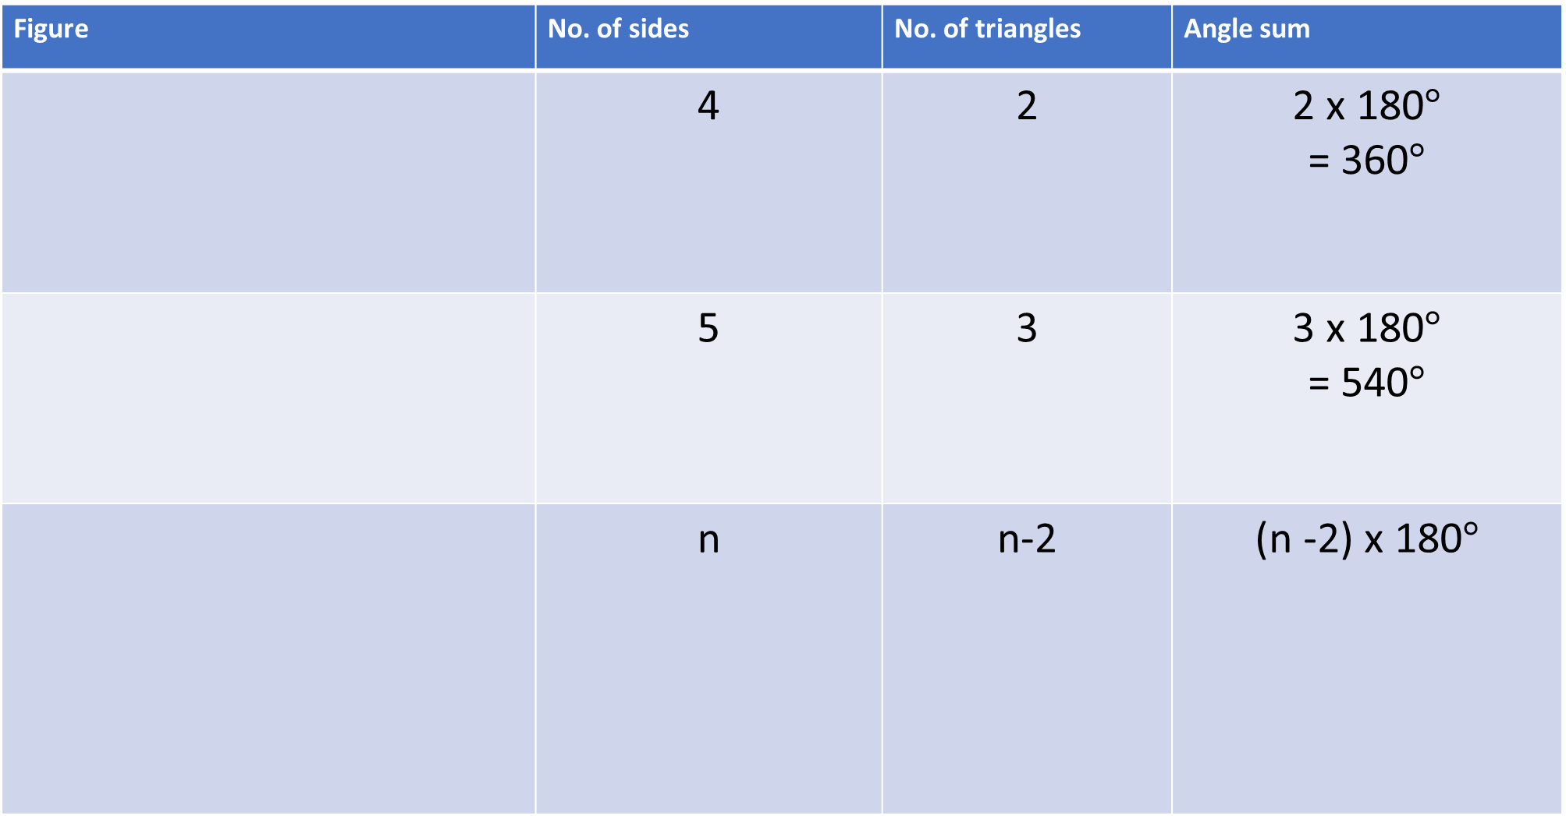
Figure | No. of sides | No. of triangles | Angle sum
 | 4 | 2 | 2 x 180$°$ = 360$°$
 | 5 | 3 | 3 x 180$°$ = 540$°$
 | n | n-2 | (n -2) x 180$°$

Slide 13
You have seen that in a quadrilateral the no. of triangles formed is 2.In a pentagon the no. of triangles formed is 3.So you can observe that in a polygon the number of triangles is two less than that of the number of sides.
In a quadrilateral , no. of triangle =2
Therefore, angle sum of a quadrilateral = 2 x180$°$=360$°$
In a pentagon, no. of triangles =3
Hence , angle sum of a pentagon= 3 x 180$°$= 540$°$
In general, angle sum of a polygon of ‘n’ sides= (n-2) x 180$°$

Slide 14
Practice Problems
Q.1.Find the sum of angles of a convex polygon of 8 sides.
Soln. We know, angle sum of a polygon of ‘n’ sides = (n-2) x 180$°$
Number of sides = 8 ,i.e. It is an octagon.
$∴$sum of angles of an octagon = ( 8 -2) x 180$°$
=6 x 180$°$
= 1080$°$
Q.2. The angles of a quadrilateral are 120$°$, 130$°$, 50$°$.Find the fourth angle.
Soln. Let the measure of the fourth angle be = x$°$

Slide 15
We know that sum of the angles of a quadrilateral is = 360$°$ So, 120$°+$130$°+$ 50$°+$x$°$ = 360$°$ i.e. 300$°$ + x$°$ = 360$°$, Thus, x$°$ = 360$°$ - 300$°$ = 60$°$
Q.3 Find the measure of each of the interior angle of a regular pentagon.
Soln. In a regular polygon, we know that,
measure of interior angle = $\frac{\left(n−2\right)x 180°}{n}$
= $\frac{\left(5−2\right)x 180°}{5}$
= $\frac{3 x 180°}{5}$
= $\frac{540°}{5}$
Measure of each int. angle of
a regular pentagon = 108$°$

Slide 16
Q.4. Find the angles of a quadrilateral if its angles are in the ratio 1:2;3:4 Soln. Let the angles of a quadrilateral be x,2x,3x & 4x
By angle sum property of a quadrilateral, we get
x +2x +3x +4x = 360
10x = 360
x = 360/10 =36
2x = 2 x 36 =72
3x = 3 x 36 = 108
4x = 4 x 36 = 144
Thus 4 angles of the quadrilateral are 36$°$, 72$°$, 108$°$, 144$°$.

Slide 17
Worksheet 1 Module1/4 Understanding Quadrilaterals
Q.1. Fill in the blanks
1. A quadrilateral has ------diagonals.
2. The sum of the angles of a quadrilateral is ------.
3. The sum of the angles of a quadrilateral is ----- right angles.
4. The number of sides and the number of diagonals is same in a --.
5. The regular polygon having 4 sides is called a -----.
Q.2. The angles of a quadrilateral are in the ratio 3:5:7:9. Find the angles of the quadrilateral.

Slide 18
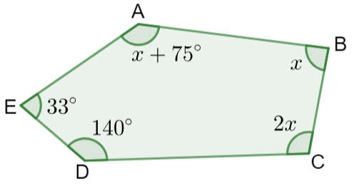
Q.3. Three angles of a quadrilateral are equal. Fourth angle is of measure 150$°$. What is the measure of each of the equal angles ? Q. 4.Three angles of a quadrilateral are 110$°$,50$°$ and 40$°$ . find the measure of its fourth angle.
Q.5. If the sum of two angles of a quadrilateral is 180$°$, what is the sum of remaining two angles?
Q.6. How many sides has a regular polygon, each angle of which is of measure 108$°?$
Q.7. The interior angle of a regular polygon is 156$°$. Find the number of sides of the polygon.
Q.8. What is the measure of each angle of a regular
hexagon ?
Q.9. Find ‘x’ in the figure shown aside.

Slide 19
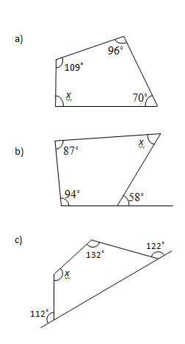
Q.10.Find ‘x’ in the following figures.

Slide 20
Thank You
Made by- Bhavana Dale
AECS-1,TARAPUR

